Slide 1




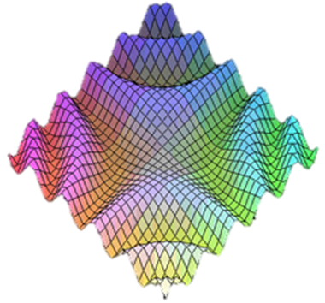
JavaScript Design Patterns
Private Fields, Module, Revealing Module, Revealing Prototype, …
Advanced
JavaScript
SoftUni Team
Technical Trainers
JS Patterns
Software University
http://softuni.bg

Slide 2

Table of Contents
Why we need modules and patterns?
"Prototype" Pattern
"Module" Pattern
"Revealing Module" Pattern
"Revealing Prototype" Pattern
Augmenting Modules
Method Chaining
JS Patterns

Slide 3
Why we need modules and patterns?
Modularity
Easy maintenance
No duplicate function names
Don't pollute the global scope

Slide 4
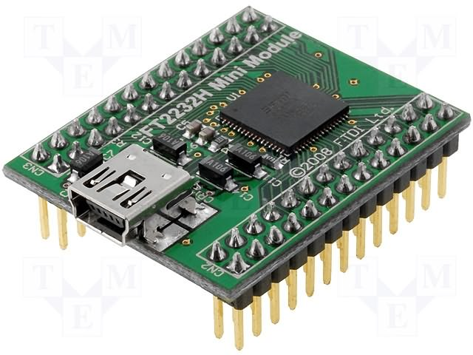
The Prototype Pattern

Slide 5
Prototype Pattern – Pros and Cons
Pros:
“Modularize” code into re-useable objects
Variables / functions are NOT in the global scope
Functions loaded into memory once
Possible to "override" functions through prototyping
Cons:
"this" can be tricky
Constructor separate from prototype definition

Slide 6
Prototype Pattern - Example
var Calculator = function(name) {
this.name = name;
};
Calculator.prototype = {
add: function (x, y) {
return (x + y);
}
}
var calc = new Calculator("SoftUniCalc");
calc.add(2, 4);

Slide 7
Prototype Pattern – Summary
Prototype pattern leverages intrinsic JavaScript functionality
Comprised of a constructor and a prototype
Provides extension capabilities

Slide 8
The "Module" Pattern
Hiding Members

Slide 9
Module Pattern – Pros and Cons
Pros:
“Modularize” code into re-useable objects
Variables / functions are NOT in the global scope
Expose only public members
Hide internal data and functions
Cons:
Not easy to extend
Some complain about debugging

Slide 10
Module Pattern: Structure
var calculator = (function() {
// private variables
// private functions
return {
// public members
func: function () { … }
};
}());

Slide 11
Module Pattern: Example
var calculator = (function () {
function logAction(action) { … }
return {
add: function (x, y) {
logAction('add');
return (x + y);
},
multiply: function (x, y) {
return (x * y);
}
};
}());
calculator.add(3, 3);
calculator.multiply(7, 8);
Private members
Public members
You can call without new

Slide 12
Module Pattern – Summary
Module pattern provides encapsulation of variables and functions
Provides a way to add visibility to members
Public versus private members
Each object instance creates new copies of functions in memory

Slide 13

Module Pattern
Live Demo

Slide 14

The Revealing Module Pattern
Revealing Module
JS Patterns
Reveal the Most Interesting Members

Slide 15
Revealing Module Pattern – Pros and Cons
Pros:
"Modularize" code into re-useable objects
Variables / functions taken out of the global namespace
Expose only visible members
"Cleaner" way to expose public members
Easy to change members privacy
Cons:
Not easy to extend
Some complain about debugging
Hard to mock hidden objects for testing

Slide 16
Revealing Module Pattern: Structure
var module = (function() {
// private variables
// private functions
return {
// public members
};
}());
Give only reference to exposed function

Slide 17
Revealing Module Pattern – Example
var calculator = (function () {
function logAction(action) { … };
function add(x, y) {
logAction('add');
return (x + y);
}
function multiply(x, y) {
return (x * y);
}
return {
add: add,
multiply: multiply
};
}());
calculator.add(3, 3);
Hidden function
Create a function constructor hidden
Expose (reveal) only public members

Slide 18
Revealing Module Pattern - Summary
Revealing Module Pattern provides encapsulation of variables and functions
Provides a way to add visibility
Public versus private members
Cleaner way to expose public members
Cleaner than Module pattern
Extending objects can be difficult since no prototyping is used

Slide 19
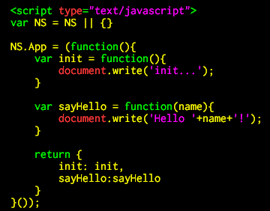
Revealing Module Pattern
Live Demo

Slide 20

The Revealing Prototype Pattern
Reveal the Most Interesting Members through the Object Prototype

Slide 21
Revealing Prototype Pattern – Pros and Cons
Pros:
"Modularize" code into re-useable objects
Variables / functions taken out of the global namespace
Expose only public members
Functions are loaded into memory once only
Extensible
Cons:
Using "this" can be tricky
Constructor is separated from the prototype
Can not be used on inheritance

Slide 22
Revealing Prototype Pattern: Structure
var Constructor = function () {
// constructor defined here
}
Constructor.prototype = (function() {
var privateFunc = 5;
function privateFunc() { … }
return {
someFunc: pointerToSomeFunc
anotherFunc: pointerToAnotherFunc
};
}());
Create IIFE for the prototype
Hidden variables
Hidden functions

Slide 23
Revealing Prototype Pattern – Example
var Calculator = function (name) { … };
Calculator.prototype = (function () {
var add, subtract, showResult, formatResult;
add = function (x) { … };
subtract = function (x) { … };
showResult = function () { … };
return {
add: add,
subtract: subtract,
showResult: showResult
};
}());
var calc = new Calculator('First');
We can have hidden data in the prototype
Expose only public methods for the prototype

Slide 24
Revealing Prototype Pattern – Summary
Revealing Prototype Pattern provides encapsulation of variables and functions
Provides a way to add visibility
Exposed versus hidden members
Provides extension capabilities

Slide 25

Revealing Prototype Pattern
Live Demo

Slide 26
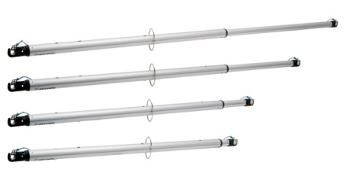
Augmenting Modules
Live Demo

Slide 27
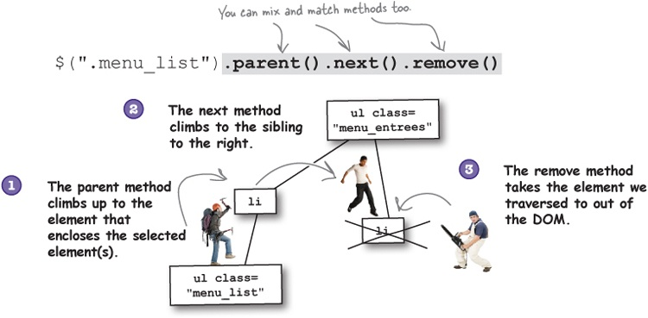
Method Chaining

Slide 28
JavaScript Method Chaining
Method chaining is a technique (pattern) that involve calling multiple functions on the same object consecutively
Much cleaner code
The code is easier to understand
No need of temporary variables to save each step of the process
var doggy = new Dog();
doggy.setName("Fluffy");
doggy.setColor("purple");
doggy.setGender("male");
var doggy = new Dog()
.setName("Fluffy")
.setColor("purple")
.setGender("male");

Slide 29
JavaScript Method Chaining – Example
var Dog = function() {
this._name = 'Fluffy';
this._color = 'purple';
}
Dog.prototype.setName = function(name) {
this._name = name;
return this;
}
Dog.prototype.setColor = function(color) {
this._color = color;
return this;
}
var doggy = new Dog().setName('Fluffy').setColor('purple');
console.log(doggy); // { _name: 'Fluffy', _color: 'purple' }

Slide 30
Method Chaining
Live Demo

Slide 31

Summary
Hidden members
Prototype Pattern
Module Pattern
Revealing Module Pattern
Revealing Prototype Pattern
Method Chaining
More information about design patterns:
http://addyosmani.com/resources/essentialjsdesignpatterns/book

Slide 32









JavaScript Design Patterns
https://softuni.bg/courses/advanced-javascript/

Slide 33
License
This course (slides, examples, demos, videos, homework, etc.) is licensed under the "Creative Commons Attribution-NonCommercial-ShareAlike 4.0 International" license
Attribution: this work may contain portions from
“JavaScript Basics" course by Telerik Academy under CC-BY-NC-SA license

Slide 34






Free Trainings @ Software University
Software University Foundation – softuni.org
Software University – High-Quality Education, Profession and Job for Software Developers
softuni.bg
Software University @ Facebook
facebook.com/SoftwareUniversity
Software University @ YouTube
youtube.com/SoftwareUniversity
Software University Forums – forum.softuni.bg

